Slide 1

ABYFARM
TRAY MANAGEMENT SYSTEM
IAPPS PTE LTD

Slide 2

OVERALL FLOW
POST GERMINATION
FOR PACKAGING
SHIFTING TO HIGHEST POSSIBLE LEVEL TO MAXIMISE SUNLIGHT EXPOSURE FOR OPTIMAL GROWTH
TRAY ID SHOULD BE TAGGED FOR CUSTOMERS TO BE ABLE TO TRACE THE JOURNEY TAKEN BY THE VEGETABLE/CROP
LOADING
BOTTOM UP APPROACH

Slide 3
PROCESS
LOADING
SHIFTING
GRADUALLY FILL TO THE TOP
CONSIDER OTHER RACKS IF ALL ARE FILLED
START FROM THE BOTTOM
AVOID LOADING SEEDS (UNGERMINATED) TO THE TOP LEVEL

Slide 4
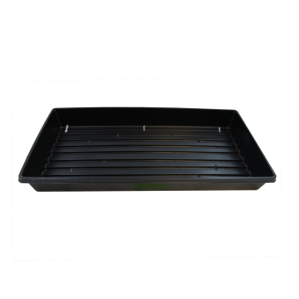
GERMINATED SEEDS SHOULD BE SHIFTED UP EVENTUALLY
HENCE, LOAD SEEDS FROM THE BOTTOM.
GOING ONLINE
BOTTOM UP
LOADING OF TRAYS SHOULD FOLLOW A
BOTTOM UP APPROACH
FIRST
(TRAY OF SEEDS)

Slide 5
PROCESS
POST GERMINATION
SHIFTING
IF TOP TRAY OF SEEDS HAVE GERMINATED, LOOK FOR OTHER RACKS.
MAKE THE SWITCH
IF ALL OTHER RACKS HAVE THEIR TOP TRAY OCCUPIED, REPEAT PROCESS FOR 2ND HIGHEST TRAY
SHIFT TO THE TOP

Slide 6
GOING ONLINE
ONE WEEK LATER
SHIFT THE TRAY WITH GERMINATED SEEDS TO THE TOP MOST. IF IT IS OCCUPIED, LOOK FOR VACANT SLOTS IN OTHER RACKS.

Slide 7
PROCESS
FOR PACKAGING
SHIFTING
SEND IT TO PACKING ROOM
SHIFT EXISTING TRAY OF SEEDLINGS (GROWING) THAT ARE NOT ON HIGHEST LEVEL TO THE NEWLY VACANT TRAY SLOT
RETRIEVE TRAY OF VEGETABLES
NOTE DOWN TRAY ID (QR CODE)

Slide 8
HARVESTING
PACKING ROOM

Slide 9
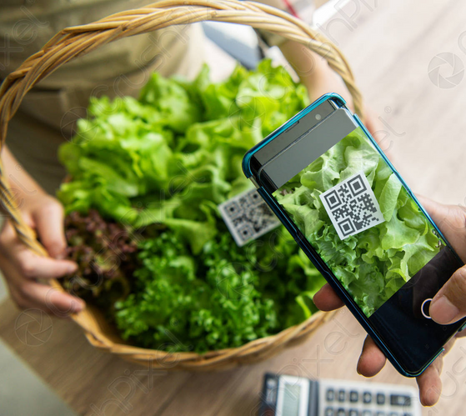
PACKING ROOM
TRAY
PACKAGED
DELIVERY
RECORD DOWN TRAY ID
QR CODE PROVIDES ALL DETAILS OF CROPS - TAGGED BY TRAY ID

